Slide 1
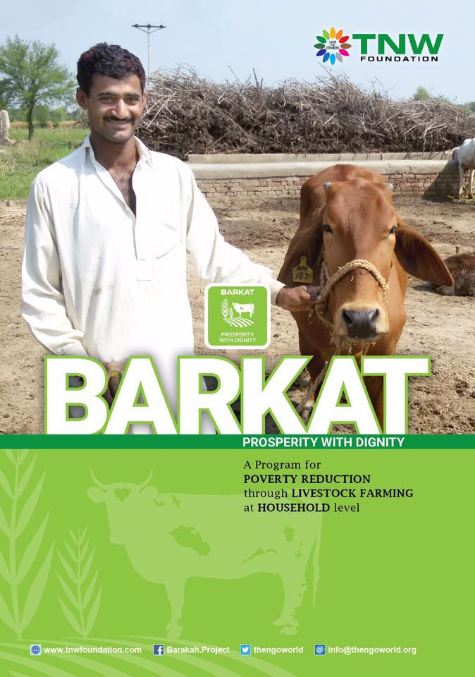

ZAFAR IQBAL
Founder/Executive Director
The NGO World-Pakistan

Slide 2
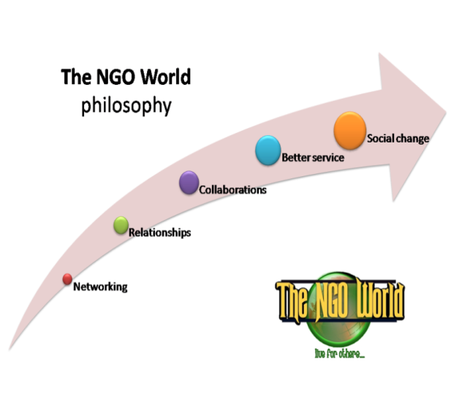

Slide 3
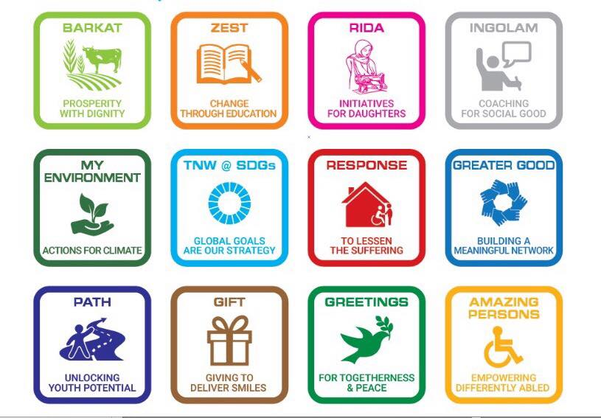

P
R
O
G
R
A
M
S

Slide 4
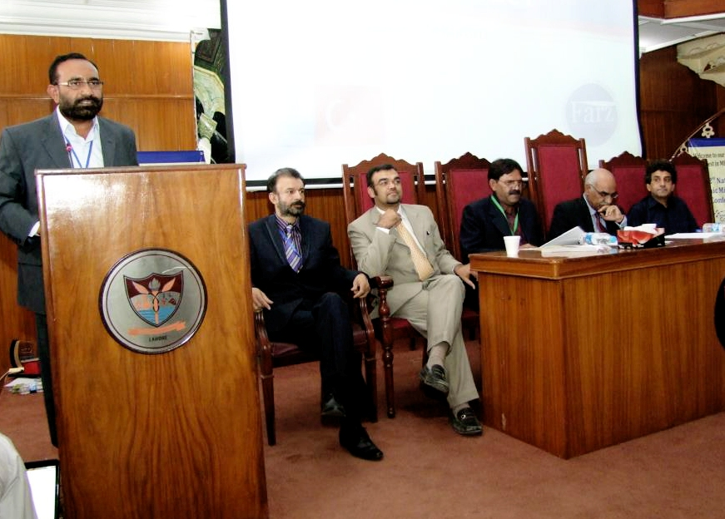

2012

Slide 5
A scheme/instrument i.e.- ethical alternative to poverty alleviation
A special kind of partnership, TNW provides the Cattle (rabb-ul-maal) to the FARMER (mudarib) as investment.
Both parties share profit and loss

Slide 6
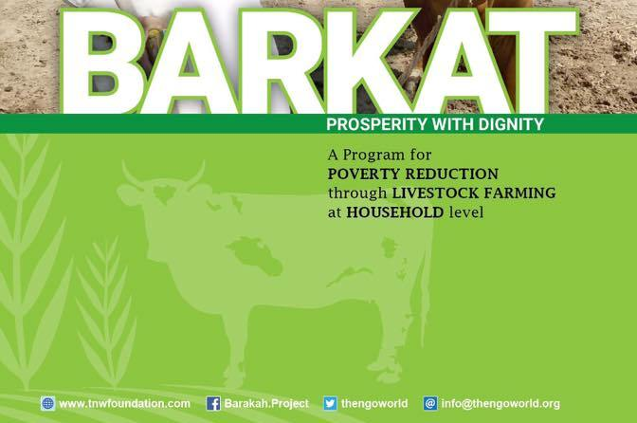
2012
keeping in view the situation of poverty in rural areas and importance of livestock, TNW Foundation launched a livestock-based poverty alleviation program titled “BARKAT” by initially distributing 100 cows (heifer) and 200 goats to small home based livestock farmers on partnership.

Slide 7
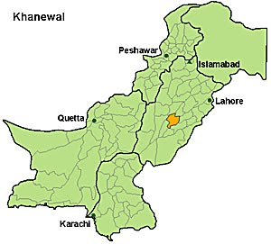

Slide 8

بركة

Slide 9
Through BARKAT we aim to…
Enhance earning of rural families engaged in livestock rearing (poor and low-income) by keeping their dignity intact (PARTNER)-EMPOWERMENT
Provide technical knowledge about better livestock farming and create awareness to get maximum BENEFITS out of cattle
Support the PARTNERS in educating their children, by giving skills to their youth and girls etc. SOCIAL SUPPORT
Raise awareness about other social issues and connecting them with sources of social support. NETWORKING

Slide 10
1- “The NGO World”(TNW) provides domestic cattle(goats, Cows, Bulls) by signing an agreement with the poor and low-income families (FARMERS) based on specific set of term and conditions for different animals.
2- During the period FARMERS will take care of cattle (fodder/protection) while ORGANIZATION will be provide services for animal’s health and raising awareness about social good. families and use this basic resource and profit to uplift them.

Slide 11
3- After the agreed period animals will be sold and profit/loss will be divided between the FARMERS and ORGANIZATION according to the terms & conditions of agreement signed.
4- The farming FAMILY will enjoy the PROFIT and hopefully its living condition will be improved. ORGANIZATION will target an other poor families and use this basic resource and profit to uplift them.

Slide 12
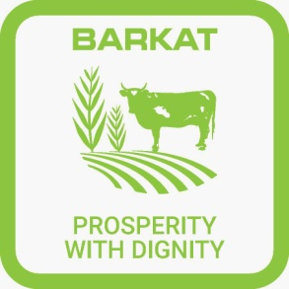
EXPERIENCES & CHALLANGES
Barkat Models
Goats
Bull
2nd Calving
Cow
1st Calving
1 Bull
2 Bulls

Slide 13
STEPS & PROCEDURES
Need Assessment | Agreement with partners
Area Selection | Tagging and handing over
Social Mobilization | Regular monitoring
Screening of partners | Awareness and social services
Community organization | Vaccination, Medication and A.I
Breed finalization | Sale of animals
Purchase of animals | Profit/Loss Sharing

Slide 14
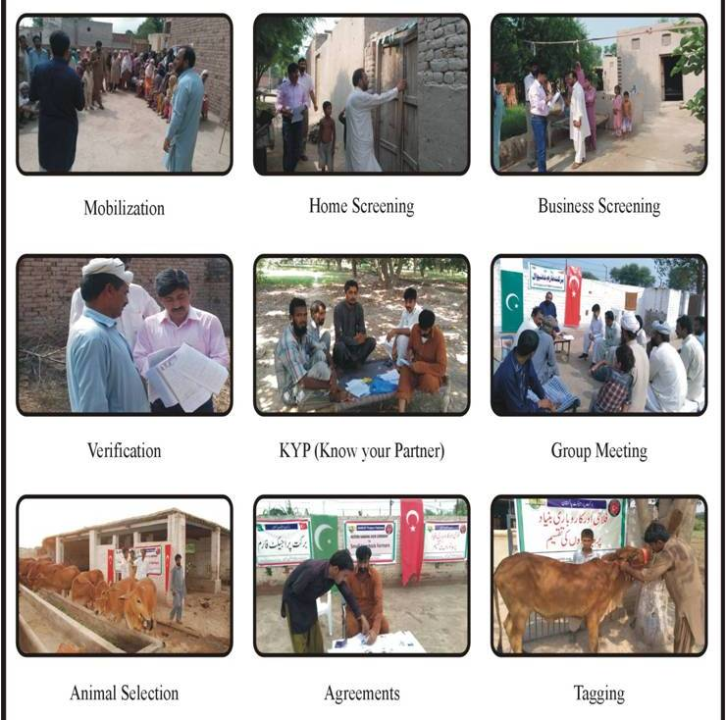

Slide 15
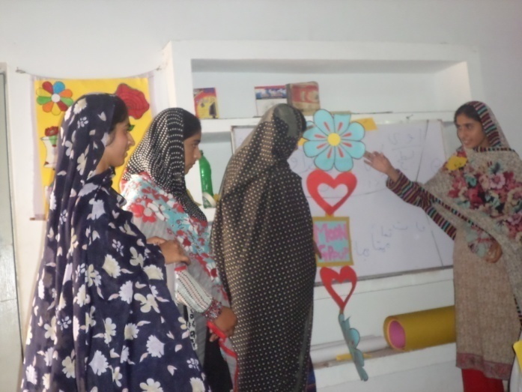
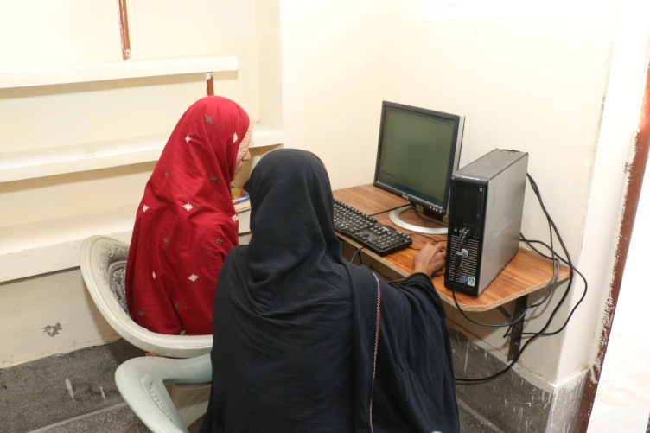
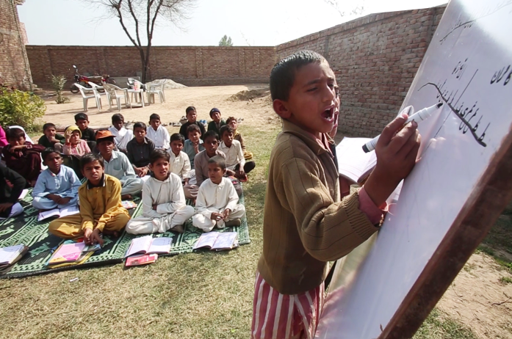
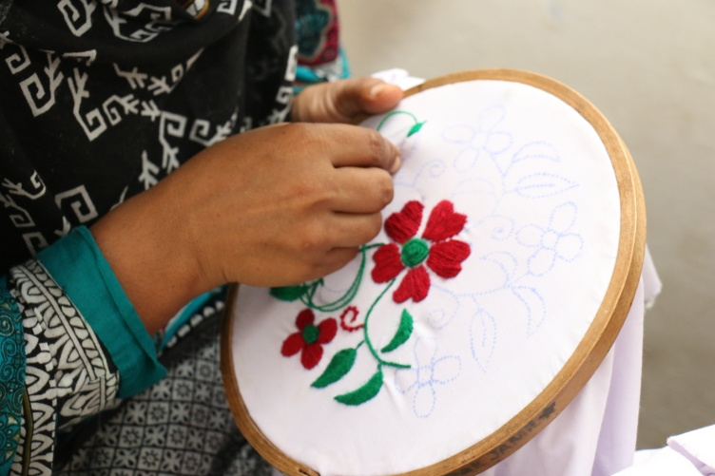
COMPLEMENTARY SOCIAL SERVICES

Slide 16
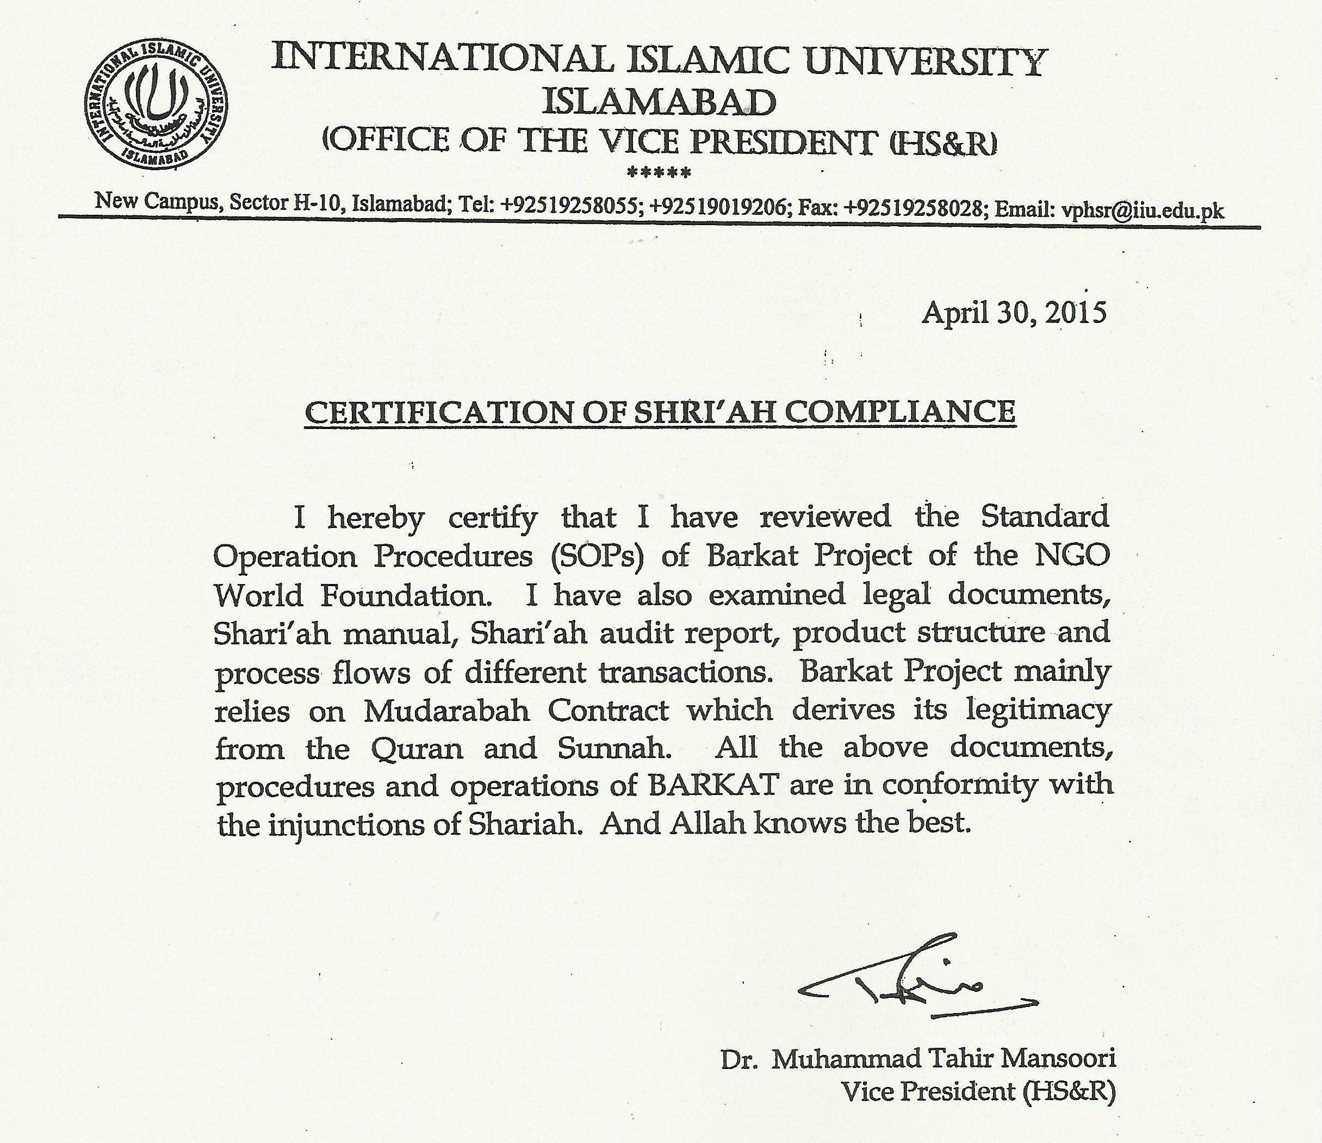
MUDARABAH

Slide 17
STRENGTHS & POTENTIAL
Once started; It is self SUSTAINABLE
Develops a CHAIN of beneficiaries
CONVENTIONAL and well documented
COMPATIBLE with nature and values of rural communities
Farmers ADOPT it as a noble profession
Easy access to MARKET

Slide 18
STRENGTHS & POTENTIAL
PROFITABLE (business and hobby)
RECOVERY is 100%
CLIMATE FRIENDLY (Natural resources, soil improvement)
Shari’ah COMPLIANT
It can be started as SOCIAL ENTERPRISE
The is potential for EXPANSION & REPLICATION

Slide 19
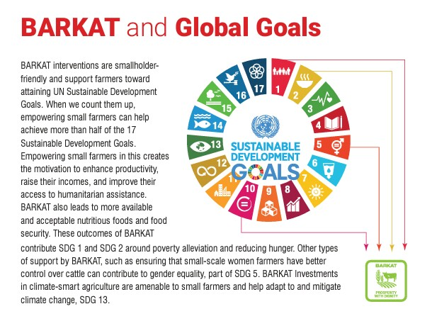

Slide 20
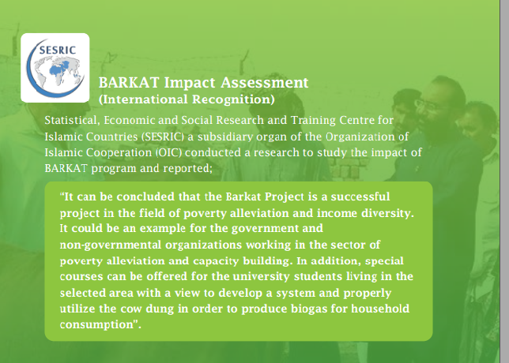

Slide 21
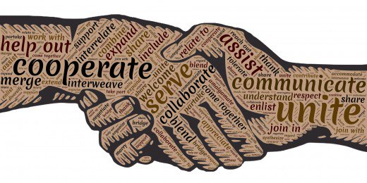
COME with BARKAT to bring prosperity
NGOs/Donors
Business Company
CSR & Philanthropists
Social Entrepreneurs
Individuals

Slide 22






Networking and Support

Slide 23


